Slide 1

#LifeKoKaroLift
Full Stack Development Program

Slide 2


Course : Backend Development Program
Lecture On : Introduction to Java
Instructor : Shubham Sharma

Slide 3
Today’s Agenda
1
What is Java?
2
Installation of Java and Testing of installation
3
A Basic Java Program
4
Execution of a Java Program
5
Variables and Data Types used in Java

Slide 4
What is Java? - Features
General Purpose Programming Language(Domain Independent)
Object Oriented
Developed by James Gosling (Sun Microsystems)
Platform Independent
Architecture Neutral
Robust(Compile Time or Runtime Error Checking)
Multithreaded
Interpreted

Slide 5
What is Java? - Features
Statically typed (Compile time type checking and fixed types)
Strongly typed (Type is important during conversion)
Automatic Memory Management (No Pointers )

Slide 6
Installation of Java and Testing Installation
Step 1: Download JDK
Step 2: Install JDK
Include JDK's "bin" Directory in the PATH
Verify the JDK Installation

Slide 7
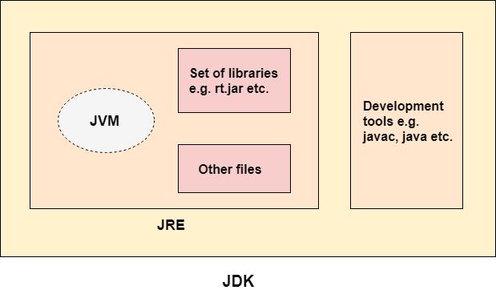
Java Development Kit(JDK)

Slide 8
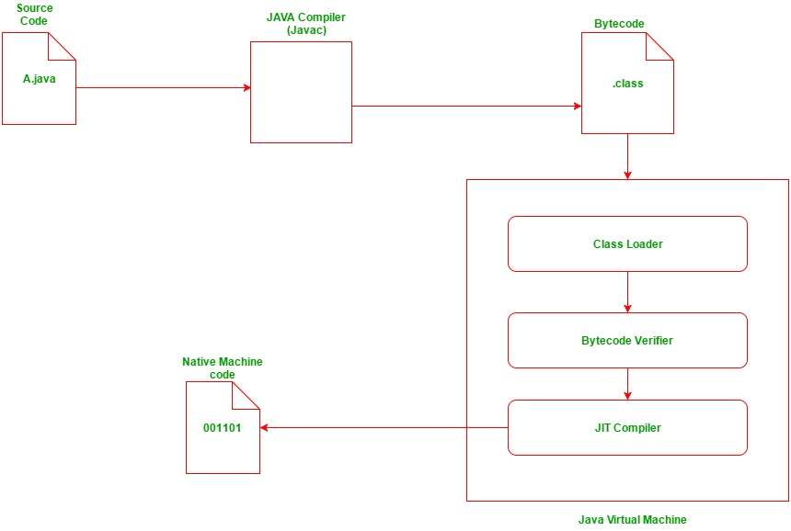
Execution of a Java Program

Slide 9
Variables and Data Types in Java
“Variables are holders of bits with a designated type”
Rules for declaring identifiers :
Identifiers must start with a letter, a currency character ($), or a connecting character such as the underscore (_).
Identifiers cannot start with a digit!
After the first character, identifiers can contain any combination of letters, currency
characters, connecting characters, or numbers.
In practice, there is no limit to the number of characters an identifier can contain

Slide 10
Types of Variables
Local Variables
(inside a method or a block)
Instance Variables
(inside a class)
Objects
(instances of class)

Slide 11
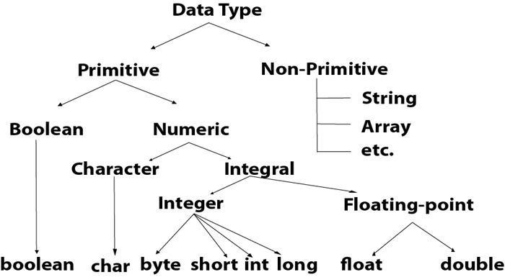
Data Types in Java

Slide 12
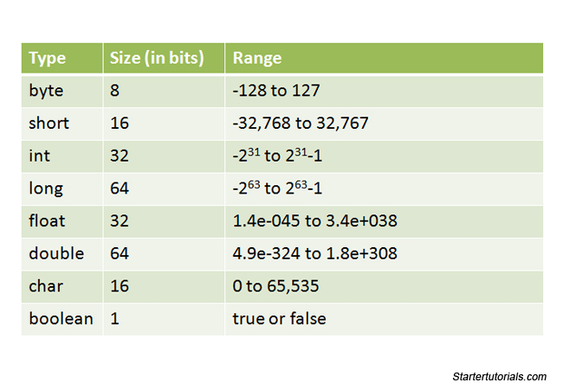
Data Types in Java
ALL FOLLOW THE RULE ---> Range = -2^{(bits-1)} to 2^{(bits-1)}-1
EXCEPT CHAR ----> Range = 0 to 2^{bits} -1

Slide 13



Poll 2
The size of boolean is :
1 bit
2 bits
0 bit
VM Dependent
Practice in teams of 4 students
Industry expert mentoring to learn better
Get personalised feedback for improvements
04/09/19
11

Slide 14
Poll 2
The size of boolean is :
1 bit
2 bits
0 bit
VM Dependent
Practice in teams of 4 students
Industry expert mentoring to learn better
Get personalised feedback for improvements
04/09/19
11

Slide 15
Poll 2
Which of the following will give a Loss of Precision Error :
String s=null;
float d=2.330;
char c = 2;
None of the above
Practice in teams of 4 students
Industry expert mentoring to learn better
Get personalised feedback for improvements
04/09/19
11

Slide 16
Poll 2
Which of the following will give a Loss of Precision Error :
String s=null;
float d=2.330;
char c = 2;
None of the above
Practice in teams of 4 students
Industry expert mentoring to learn better
Get personalised feedback for improvements
04/09/19
11

Slide 17
Key Takeaway
1
What is Java?
2
Installation of Java and Testing of installation
3
A Basic Java Program
4
Execution of a Java Program
5
Variables and Data Types used in Java

Slide 18
Next Class
1
Operators in Java

Slide 19
#LifeKoKaroLift
Thank You!

